Slide 1
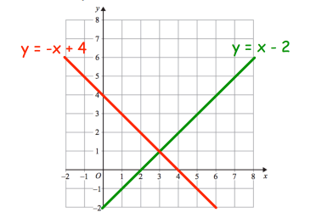
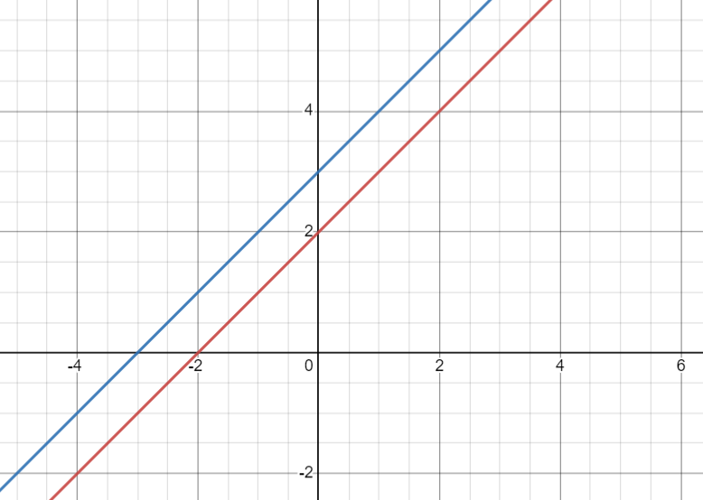
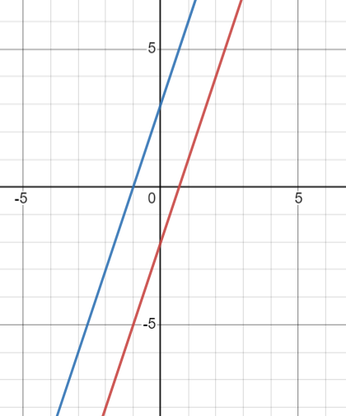
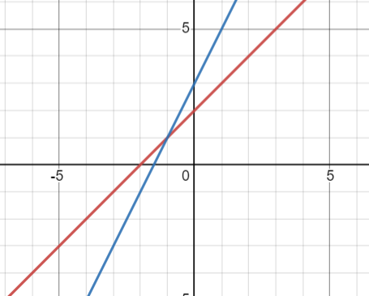
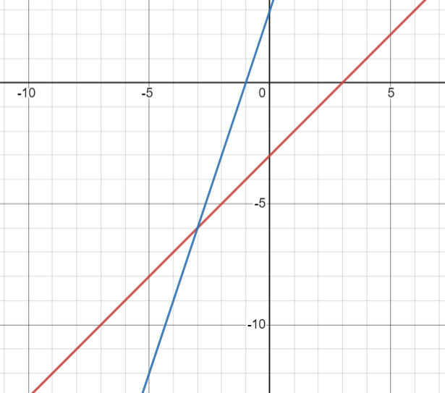
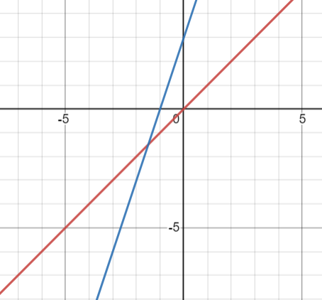
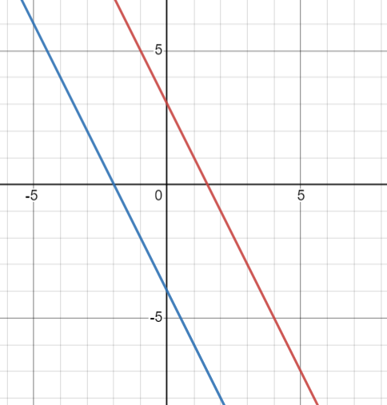
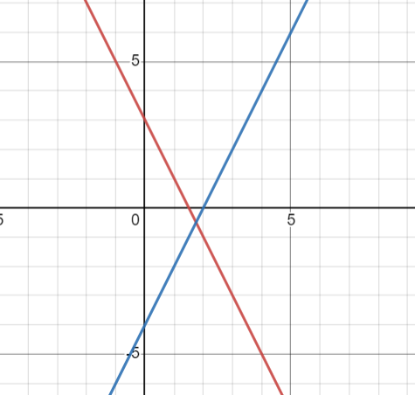
Subtopic 3a – Solving simultaneous equations graphically
LEARNING OUTCOME: Solve simultaneous equations in two variables by the graphical method
Objectives:
Keywords:
Simultaneous equations
Linear equations
Equivalent equations
Intersection
Solve graphical simultaneous equations from a given graph.
Solve graphical simultaneous equations by plotting one or both lines.
Definition
Characteristics
Two equations that form straight lines that intersect at one point.
Linear simultaneous equations are two straight line equations that have an intersection point (this means they cross on the graph).
Examples
Graphical simultaneous equations
Non - Examples
These equations do not intersect, therefore they are not simultaneous.
These are simultaneous equations because they intersect at a point.
KNOWLEDGE CHECK
Do these graphs intersect?
Y N
Y N
Y N
Y N
Y N
Y N

Slide 2
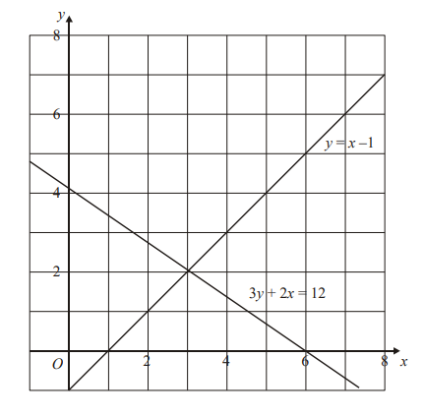
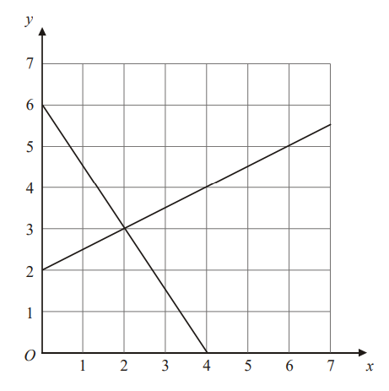


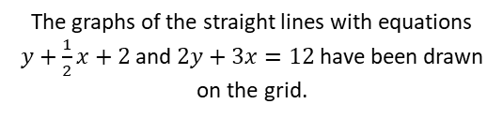


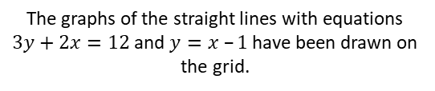


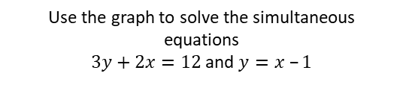

Example 1 - I do…
Example 2 – We do…
The graphs of the straight lines with equations
$3y+2x=12$and $y=x –1$have been drawn on the grid.
The graphs of the straight lines with equations
$y+\frac{1}{2}x+2$and $2y+3x=12$have been drawn on the grid.
Use the graph to solve the simultaneous equations
$3y+2x=12$and $y=x –1$
Use the graph to solve the simultaneous equations
$y+\frac{1}{2}x+2$and $2y+3x=12$
Step 1:
Find the intersection point.
Step 2:
Draw a line from the intersection point to the $x−$axis.
Step 3:
Draw a line from the intersection point to the $y$-axis.
Step 4:
Write the $x$ and $y$ coordinates as the solution.
Step 1:
Find the intersection point.
Step 2:
Draw a line from the intersection point to the $x−$axis.
Step 3:
Draw a line from the intersection point to the $y$-axis.
Step 4:
Write the $x$ and $y$ coordinates as the solution.
$x$ =
$x$ =
$y$ =
$y$ =

Slide 3
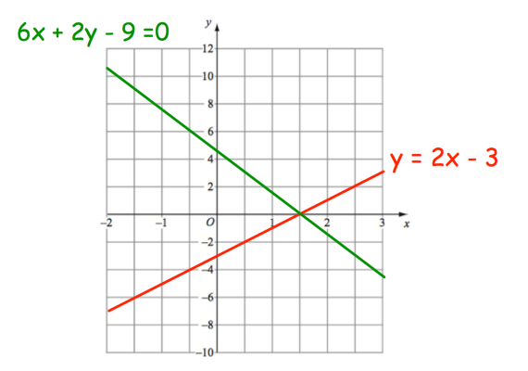
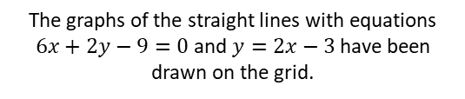
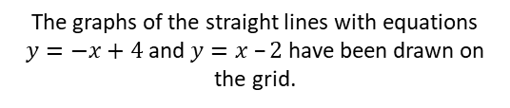

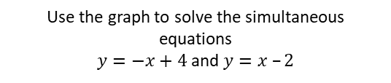
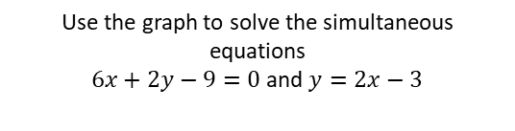
Example 3 - You do…
Example 4 – You do…
The graphs of the straight lines with equations
$y=−x+4$and $y=x –2$have been drawn on the grid.
The graphs of the straight lines with equations
$6x+2y−9=0$and $y=2x−3$have been drawn on the grid.
Use the graph to solve the simultaneous equations
$y=−x+4$and $y=x –2$
Use the graph to solve the simultaneous equations
$6x+2y−9=0$and $y=2x−3$
Step 1:
Find the intersection point.
Step 2:
Draw a line from the intersection point to the $x−$axis.
Step 3:
Draw a line from the intersection point to the $y$-axis.
Step 4:
Write the $x$ and $y$ coordinates as the solution.
Step 1:
Find the intersection point.
Step 2:
Draw a line from the intersection point to the $x−$axis.
Step 3:
Draw a line from the intersection point to the $y$-axis.
Step 4:
Write the $x$ and $y$ coordinates as the solution.
$x$ =
$x$ =
$y$ =
$y$ =

Slide 4
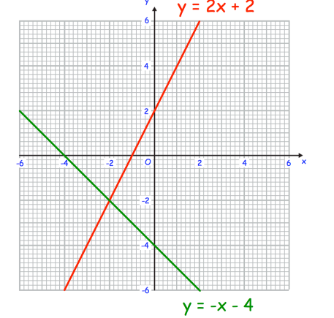
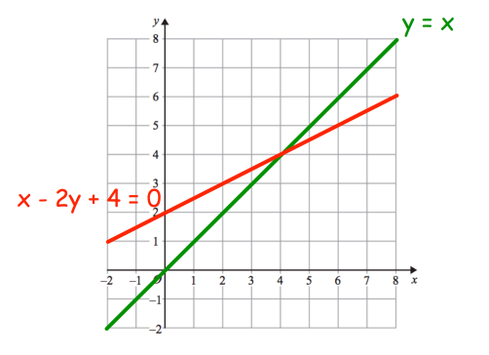
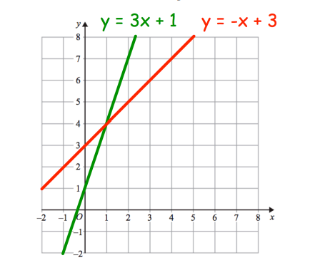
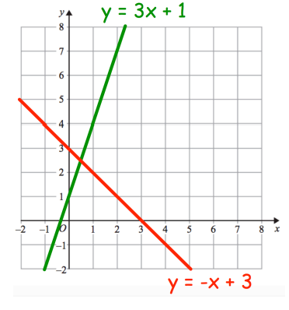
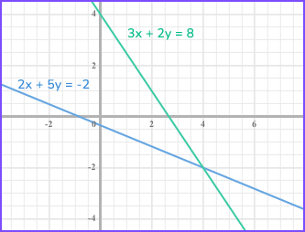



INDEPENDENT PRACTICE
1) Solve the simultaneous equations graphically
a)
b)
$x$ =
$x$ =
$y$ =
$y$ =
c)
d)
$x$ =
$x$ =
$y$ =
$y$ =
e)
$x$ =
$y$ =

Slide 5
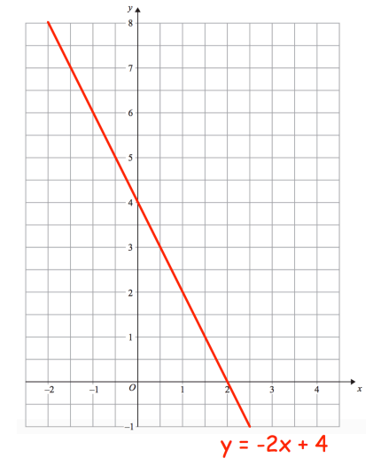
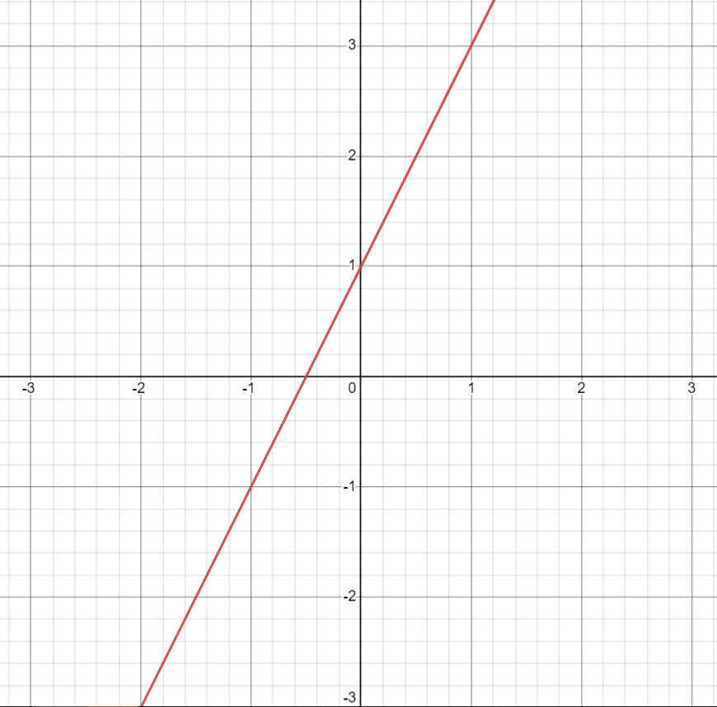



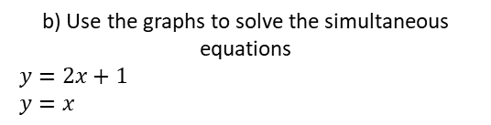
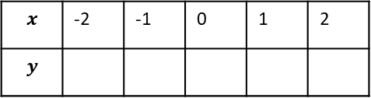
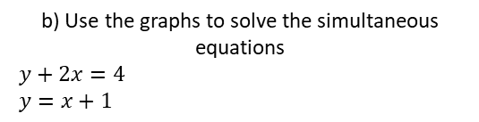
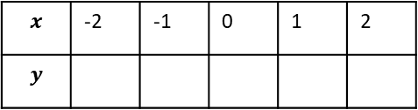
Example 5 - I do…
Example 6 – We do…
The straight line $y+2x=4$ has been drawn on the grid.
The straight line $y=2x+1$ has been drawn on the grid
a) On the same grid, draw the graph of $y=x+1$
a) On the same grid, draw the graph of $y=x$
$$x$$ | -2 | -1 | 0 | 1 | 2
$$y$$
$$x$$ | -2 | -1 | 0 | 1 | 2
$$y$$
b) Use the graphs to solve the simultaneous equations
$y+2x=4$
$y=x+1$
b) Use the graphs to solve the simultaneous equations
$y=2x+1$
$y=x$
$x$ =
$x$ =
$y$ =
$y$ =

Slide 6
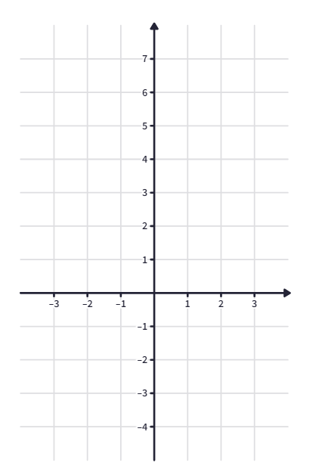
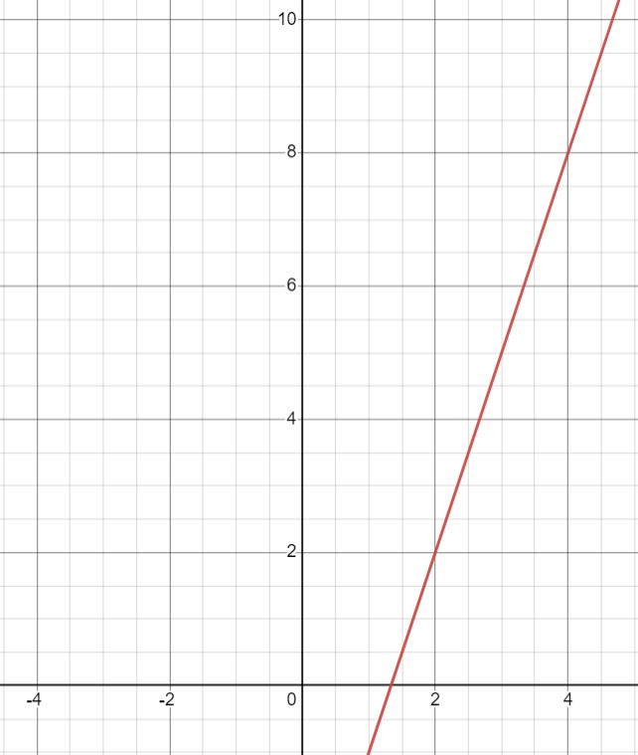
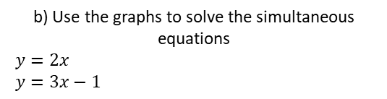
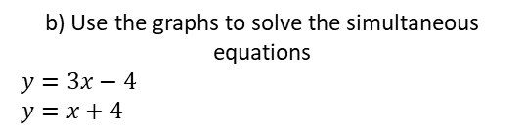

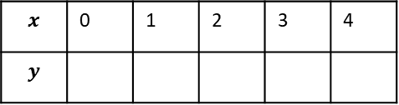



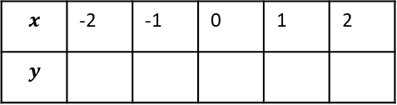
Example 7 - You do…
Example 8 – You do…
The straight line $y=2x$ has been drawn on the grid.
The straight line $y=3x−4$ has been drawn on the grid
On the same grid, draw the graph of
$y=x+4$
On the same grid, draw the graph of
$$y=3x−1$$
$$x$$ | 0 | 1 | 2 | 3 | 4
$$y$$
$$x$$ | -2 | -1 | 0 | 1 | 2
$$y$$
b) Use the graphs to solve the simultaneous equations
$y=2x$
$y=3x−1$
b) Use the graphs to solve the simultaneous equations
$y=3x−4$
$y=x+4$
$x$ =
$x$ =
$y$ =
$y$ =

Slide 7
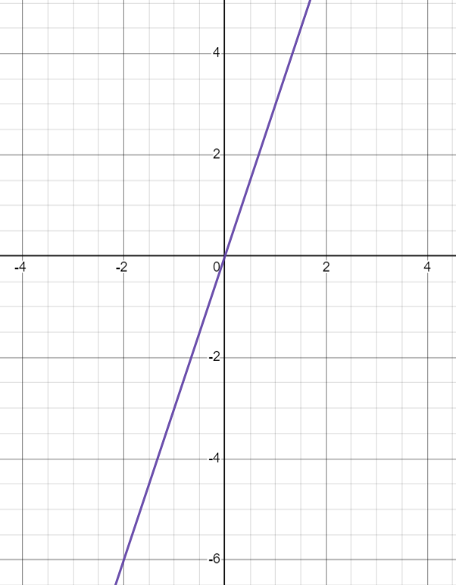
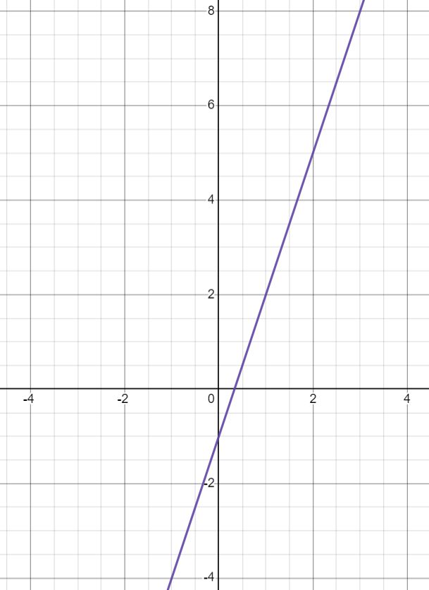



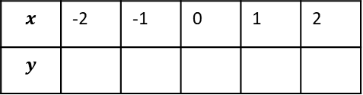

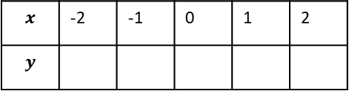
INDEPENDENT PRACTICE
Solve the simultaneous equations using the graphical method:
2a) The straight line $y=3x$ has been drawn on the grid.
On the same grid draw the graph of
$y=2x+1$
b) use the graph to find the solutions to the simultaneous equations $y=3x$and
$y=x−2$
$$x$$ | -2 | -1 | 0 | 1 | 2
$$y$$
$x$ =
$y$ =
Intersection points:
,
3a) The straight line $y=3x−1$ has been drawn on the grid.
On the same grid draw the graph of
$y=2x+1$
b) use the graph to find the solutions to the simultaneous equations $y=3x−1$and
$y=2x+1$
$$x$$ | -2 | -1 | 0 | 1 | 2
$$y$$
$x$ =
$y$ =
Intersection point:
,

Slide 8



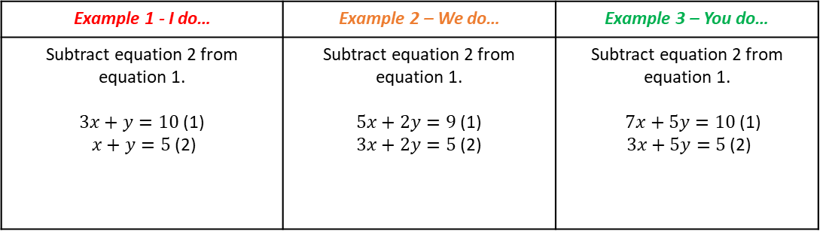















Subtopic 3b – Recap: Simultaneous equations - Elimination
LEARNING OUTCOME: To recap solving simultaneous equations using the elimination method
Objectives:
Keywords:
Simultaneous equations
Linear equations
Equivalent equations
Intersection
Elimination
To be able to eliminate variables by adding or subtracting equations.
To solve an equation with two variables by substituting a known variable.
Solve simultaneous equations using the elimination method
Definition
Characteristics
A method to eliminate one of the variables in a pair of simultaneous equations to solve for both equations.
You must equate the variables for the elimination method to work.
Examples
Elimination Method
Non - Examples
$$5x+y=11$$
$$4x+y=9$$
$x =2$
$$−$$
$$5\left(2\right)+y=11$$
$$5x+y=11$$
$$4x+y=9$$
$9x+2y=20$
$$5x+y=11$$
$$4x−y=9$$
$x =2$
$$10+y=11$$
$$+$$
$$−$$
$$−10$$
$$−10$$
$$y=1$$
Example 1 - I do… | Example 2 – We do… | Example 3 – You do…
Subtract equation 2 from equation 1. $3x+y=10$ (1) $x+y=5$ (2) | Subtract equation 2 from equation 1. $5x+2y=9$ (1) $3x+2y=5$ (2) | Subtract equation 2 from equation 1. $7x+5y=10$ (1) $3x+5y=5$ (2)
INDEPENDENT PRACTICE
1) subtract equation 2 from equation 1
1) $2x+y=10$ (1)
$x+y=5$ (2)
2) $8x+y=10$ (1)
$5x+y=5$ (2)
3) $3x+3y=10$ (1)
$x+3y=5$ (2)
4) $10x+2y=10$ (1)
$4x+2y=5$ (2)
5)$3x+4y=10$ (1)
$3x+y=5$ (2)
6) $5x+3y=10$ (1)
$5x+y=5$ (2)
7) $7x+3y=10$ (1) $7x+y=5$ (2)
8) $10x+7y=10$ (1)
$10x+2y=5$ (2)

Slide 9

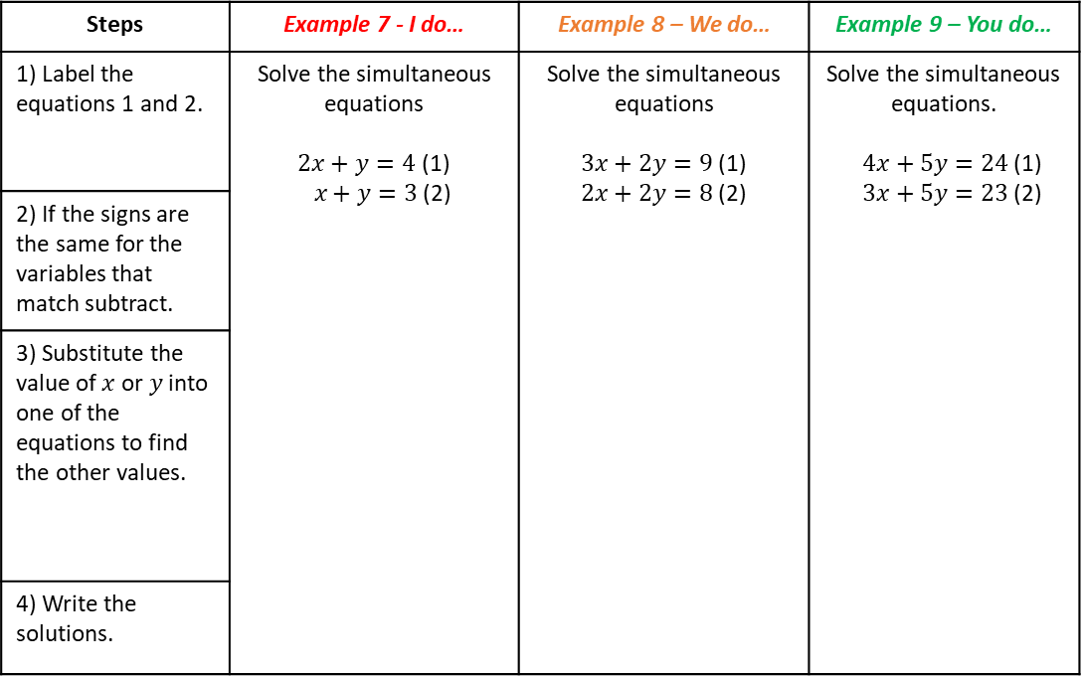







Steps | Example 7 - I do… | Example 8 – We do… | Example 9 – You do…
1) Label the equations 1 and 2. | Solve the simultaneous equations $2x+y=4$ (1) $x+y=3$ (2) | Solve the simultaneous equations $3x+2y=9$ (1) $2x+2y=8$ (2) | Solve the simultaneous equations. $4x+5y=24$ (1) $3x+5y=23$ (2)
2) If the signs are the same for the variables that match subtract.
3) Substitute the value of $x$ or $y$ into one of the equations to find the other values.
4) Write the solutions.
INDEPENDENT PRACTICE
3) Solve the simultaneous equations using elimination
a) $2x+y=5$ (1)
$x+y=4$ (2)
b) $2x+y=4$ (1)
$x+y=3$ (2)
c) $2x+y=8$ (1)
$x+y=6$ (2)
$$x=$$
$$y=$$
$$x=$$
$$y=$$
$$x=$$
$$y=$$
d) $3x+2y=29$ (1)
$2x+2y=24$ (2)
e) $4x+3y=33$ (1)
$3x+3y=30$ (2)
f) $5x+4y=60$ (1)
$4x+4y=56$ (2)
$$x=$$
$$y=$$
$$x=$$
$$y=$$
$$x=$$
$$y=$$

Slide 10





Steps | Example 10 - I do… | Example 11 – We do… | Example 12 – You do…
1) Label the equations 1 and 2. | Solve the simultaneous equations $4x+y=6$ (1) $2x+y=4$ (2) | Solve the simultaneous equations $6x+5y=27$ (1) $2x+5y=19$ (2) | Solve the simultaneous equations. $5x+2y=11$ (1) $2x+2y=8$(2)
2) If the signs are the same for the variables that match subtract.
3) Solve to find one variable.
4) Substitute the value of $x$ or $y$ into one of the equations to find the other values.
5) Write the solutions.
INDEPENDENT PRACTICE
4) Solve the simultaneous equations using elimination
a) $3x+y=6$ (1)
$x+y=4$ (2)
b) $5x+y=13$ (1)
$3x+y=9$ (2)
c) $4x+y=19$ (1)
$x+y=7$ (2)
$$x=$$
$$y=$$
$$x=$$
$$y=$$
$$x=$$
$$y=$$

Slide 11




Steps | Example 13 - I do… | Example 14 – We do… | Example 15 – You do…
1) Label the equations 1 and 2. | Solve the simultaneous equations $4x−y=6$ (1) $2x−y=4$ (2) | Solve the simultaneous equations $5x−2y=11$ (1) $2x−2y=8$(2) | Solve the simultaneous equations. $6x−5y=27$ (1) $2x−5y=19$ (2)
2) If the signs are the same for the variables that match subtract.
3) Solve to find one variable.
4) Substitute the value of $x$ or $y$ into one of the equations to find the other variable.
5) Write the solutions.
INDEPENDENT PRACTICE
5) Solve the simultaneous equations using elimination
a) $3x−y=6$ (1)
$x−y=4$ (2)
b) $5x−y=13$ (1)
$3x−y=9$ (2)
c) $4x−y=19$ (1)
$x−y=7$ (2)
$$x=$$
$$y=$$
$$x=$$
$$y=$$
$$x=$$
$$y=$$

Slide 12





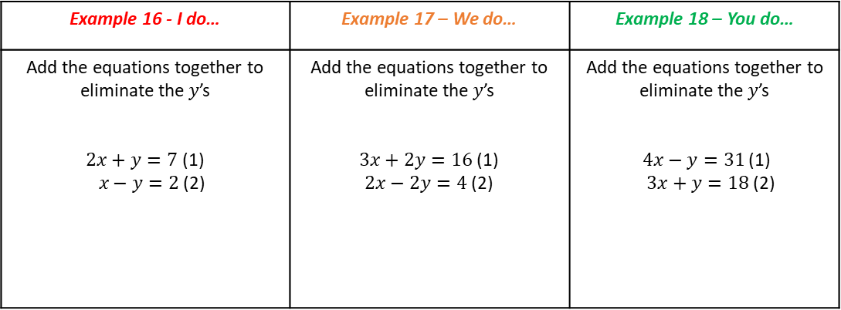








Example 16 - I do… | Example 17 – We do… | Example 18 – You do…
Add the equations together to eliminate the $y$’s $2x+y=7$ (1) $x−y=2$ (2) | Add the equations together to eliminate the $y$’s $3x+2y=16$ (1) $2x−2y=4$ (2) | Add the equations together to eliminate the $y$’s $4x−y=31$ (1) $3x+y=18$ (2)
+
+
+
INDEPENDENT PRACTICE
6) Add the equations together to eliminate the $y$’s
a) $3x+y=4$ (1)
$x−y= 0$(2)
b) $8x−y=8$ (1)
$5x+y=5$ (2)
c) $3x−3y=3$ (1)
$x+3y=5$ (2)
d) $10x−2y=8$ (1)
$4x+2y=6$ (2)
e)$3x−y=4$ (1)
$2x+y=8$ (2)
f) $4x+y=14$ (1)
$5x−y=13$ (2)
g) $8x+2y=28$ (1) $7x−2y=17$ (2)
h) $8x+7y=23$ (1)
$10x−7y=13$ (2)
i)$3x−4y=−5$ (1)
$3x+4y=11$ (2)
j) $5x−8y=−11$ (1)
$5x+8y=21$ (2)
k) $7x+9y=−5$ (1) $7x−9y=−23$ (2)
l) $10x+10y=−50$ (1)
$10x−10y=−70$ (2)

Slide 13






d) $3x+2y=22$ (1)
$2x−2y=8$ (2)
e) $5x−2y=22$ (1)
$2x+2y=20$ (2)
f) $4x+3y=50$ (1)
$2x−3y=−2$ (2)
$$x=$$
$$y=$$
$$x=$$
$$y=$$
$$x=$$
$$y=$$
g) $5x+2y=23$ (1)
$2x−2y=−2$ (2)
h) $5x−3y=0$ (1)
$3x+3y=24$ (2)
i) $4x+4y=44$ (1)
$x−4y=−24$ (2)
$$x=$$
$$y=$$
$$x=$$
$$y=$$
$$x=$$
$$y=$$

Slide 14
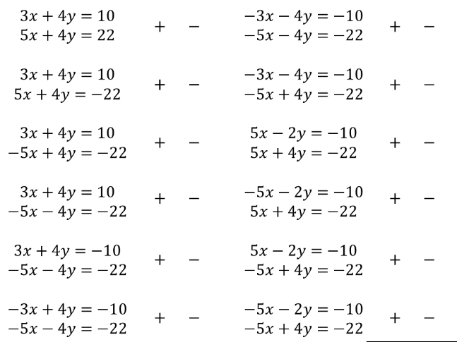



INDEPENDENT PRACTICE
8. To solve these equations should we add or subtract?
Circle either the + or -
1.
7.
2.
8.
3.
9.
4.
10.
5.
11.
6.
12.
9. Solve the simultaneous equations
a) $2x+3y=18$
$6x+3y=30$
b) $2x+y=18$
$6x−y=30$
c) $2x+3y=18$
$6x−3y=30$
x = , y =
x = , y =
x = , y =

Slide 15







INDEPENDENT PRACTICE
(d)
$$3x−y=3 \\ 5x+y=13$$
(e)
$$x−y=9$$ $3x+y=11$
(f)
2$x−y=7$ $3x+y=8$
x = , y =
x = , y =
x = , y =
(g)
$$2x−2y=5$$
$$x−2y=3$$
(h)
$$3x−4y=15$$
$$x−4y=3$$
(i)
$$3x−4y=20$$
$$x−4y=8$$
x = , y =
x = , y =
x = , y =

Slide 16

Solving simultaneous equations by adjusting one or both equations
LEARNING OUTCOME: To solve simultaneous equations using the elimination method
Objectives:
Keywords:
Simultaneous equations
Linear equations
Equivalent equations
Intersection
Elimination
Finding the LCM between two numbers.
Solving simultaneous equations by adjusting one equation.
Solving simultaneous equations by adjusting both equations.
Definition
Characteristics
Two equations that form straight lines that intersect at one point.
Linear simultaneous equations are two straight line equations that have an intersection point (this means they cross on the graph).
Examples
Simultaneous Equations
Non - Examples
These equations do not intersect, therefore they are not simultaneous.
These are simultaneous equations because they intersect at a point.
SKILLS CHECK
1) Find the lowest common multiple of these numbers
a) 3 and 9
b) 4 and 12
c) 10 and 30
d) 7 and 28
e) 21 and 42
Steps | Example 1 - I do… | Example 2 – We do… | Example 3 – You do…
1) Find the LCM of the variables. | Adjust one of the equations to make the $y^{′}s$the same. $2x+y=7$ (1) $x−3y=10$ (2) | Adjust one of the equations to make the $y^{′}s$the same $3x+4y=16$ (1) $2x+2y=4$ (2) | Adjust one of the equations to make the $y^{′}s$the same $4x−21y=31$ (1) $3x+7y=18$ (2)
2) Multiply one of the equations to make the variables the same.

Slide 17







Adjusting one equation
Steps | Example 4 - I do… | Example 5 – We do… | Example 6 – You do…
1) Label the equations 1 and 2. | Solve the simultaneous equations $2x+y=17$ (1) $3x+2y=29$ (2) | Solve the simultaneous equations $3x+y=19$ (1) $6x+3y=42$ (2) | Solve the simultaneous equations. $4x+y=11$ (1) $x+3y=11$ (2)
2) Find the LCM and adjust one of the equations.
3) If the signs are the same, subtract. If different, add.
4) Solve to find one variable.
5) Substitute the value of $x$ or $y$ into one of the equations to find the other values.
6) Write the solutions.
INDEPENDENT PRACTICE
2) Solve the simultaneous equations using elimination
a) $2x+y=5$ (1)
$3x+2y=9$ (2)
b) $2x+2y=12$ (1)
$3x+4y=22$ (2)
c) $2x+3y=28$ (1)
$3x+6y=51$ (2)
$x$ = , $y$ =
$x$ = , $y$ =
$x$ = , $y$ =

Slide 18





Steps | Example 7 - I do… | Example 8 – We do… | Example 9 – You do…
1) Label the equations 1 and 2. | Solve the simultaneous equations $2x+y=5$ (1) $3x−2y=−3$ (2) | Solve the simultaneous equations $3x−y=11$ (1) $6x+3y=27$ (2) | Solve the simultaneous equations. $4x+y=22$ (1) $x−3y=−1$ (2)
2) Find the LCM and adjust one of the equations.
3) If the signs are the same, subtract. If different, add.
4) Solve to find one variable.
5) Substitute the value of $x$ or $y$ into one of the equations to find the other values.
6) Write the solutions.
INDEPENDENT PRACTICE
3) Solve the simultaneous equations using elimination
a) $2x−2y=6$ (1)
$3x+4y=16$ (2)
b) $2x+3y=16$ (1)
$3x−6y=3$ (2)
c) $2x−y=−1$ (1)
$3x+2y=9$ (2)
$x$ = , $y$ =
$x$ = , $y$ =
$x$ = , $y$ =

Slide 19







MIXED PRACTICE
4) Solve the simultaneous equations using elimination
a) $2x+8y=43$ (1)
$x+3y=18$ (2)
b) $5x−3y=33$ (1)
$3x−9y=63$ (2)
c) $2x+4y=−2$ (1)
$4x+2y=−10$ (2)
$x$ = , $y$ =
$x$ = , $y$ =
$x$ = , $y$ =
d) $8x+4y=−28$ (1)
$3x−12y=30$(2)
e) $15x−4y=82$ (1)
$5x−9y=12$ (2)
f) $12x+3y=9$ (1)
$2x+11y=−9$ (2)
$x$ = , $y$ =
$x$ = , $y$ =
$x$ = , $y$ =

Slide 20




Adjusting both equations
Steps | Example 10 - I do… | Example 11 – We do… | Example 12 – You do…
1) Label the equations 1 and 2. | Solve the simultaneous equations $4x+2y=8$ (1) $3x+3y=9$ (2) | Solve the simultaneous equations $3x+2y=13$ (1) $6x−5y=8$ (2) | Solve the simultaneous equations. $4x+3y=29$ (1) $x+5y=20$ (2)
2) Find the LCM and adjust both of the equations.
3) If the signs are the same, subtract. If different, add.
4) Solve to find one variable.
5) Substitute the value of $x$ or $y$ into one of the equations to find the other values.
6) Write the solutions.
6) Solve the simultaneous equations by adjusting both equations
a) $2x+2y=14$ (1)
$5x−3y=19$ (2)
b) $2x+3y=1$ (1)
$7x+2y=−22$ (2)
c) $5x+3y=−4$ (1)
$2x+4y= 4$ (2)

Slide 21






g) $3x+8y=31$ (1)
$5x+3y=31$ (2)
h) $7x−15y=2.5$ (1)
$3x−2y=5.5$ (2)
i) $3x+2y=53$ (1)
$2x+5y=72$ (2)
$x$ = , $y$ =
$x$ = , $y$ =
$x$ = , $y$ =
j) $5x−3y=18$ (1)
$2x+4y=54$(2)
k) $2x+8y=8$ (1)
$9x+3y=−63$ (2)
l) $2x−4y=4$ (1)
$5x−3y=24$ (2)
$x$ = , $y$ =
$x$ = , $y$ =
$x$ = , $y$ =

Slide 22



3) Solve the simultaneous equations by rearranging and then using elimination.
a) $x=10−y$ (1)
$2x+y=17$ (2)
b) $x−4=y$ (1)
$x+3y=12$ (2)
c) $2x+6y=4$ (1)
$x=12+2y$ (2)
$x$ = , $y$ =
$x$ = , $y$ =
$x$ = , $y$ =
4) Two cats and a dog cost £91.
Three cats and two dogs cost £159.
How much does a cat cost?
Hint: form equations

Slide 23
Subtopic 3c – Simultaneous equations – Worded Problems
LEARNING OUTCOME: To solve simultaneous equations in worded problems
Objectives:
Keywords:
Simultaneous equations
Linear equations
Equivalent equations
To recognise simultaneous equations in worded problems.
To be able to write worded problems as two coherent simultaneous equations, and solve these.
To be able to interpret the answers to worded simultaneous equations problems.
Definition
Characteristics
Two equations that form straight lines that intersect at one point.
Linear simultaneous equations are two straight line equations that have an intersection point (this means they cross on the graph).
Examples
Simultaneous equations
Non - Examples
These equations do not intersect, therefore they are not simultaneous.
These are simultaneous equations because they intersect at a point.
Key steps
Convert each sentence to an equation.
Solve the simultaneous equations.
Answer the question.
Example 1 - I do…
David buys 2 scones and 2 coffees in a shop and the cost is £18.
Eliza buys 3 scones and 2 coffees in the same shop and they cost £22.
Find the cost of each scone and each coffee.

Slide 24
Example 2 – We do…
The cost of buying a coffee and a tea in a café is £4.
The cost of buying a coffee and three teas in a café is £7.
Work out the cost of buying 2 coffees and the cost of buying 3 teas.
Example 3 – You do…
Five adult tickets and three child tickets for a movie cost £58.
Two adult tickets and eight child tickets for a movie cost £47.
Find the cost of each type of ticket.

Slide 25
INDEPENDENT PRACTICE
1. Solve the following
a) Sweets are sold in small packs and in big packs.
There is a total of 175 sweets in 4 small packs and 3 big packs.
There is a total of 154 sweets in 5 small packs and 2 big packs.
Work out the number of sweets in each small pack and in each big pack.
b) A plumber charges a price for each hour, £h, and a fixed charge, £c.
A 5 hour job costs £155 in total.
A 8 hour job costs £230 in total.
How much would a job that lasts 2 hours cost?
c) The sum of Rosemary’s age and Hannah’s age is 102 years.
The difference between Rosemary’s age and Hannah’s age is 52 years.
Rosemary is older than Hannah.
Find the age of each woman by using simultaneous equations.

Slide 26
3. Solve the following
a) Four sacks of potatoes and two sacks of carrots weigh 188 lb.
Five sacks of potatoes and one sack of carrots weigh 202 lb.
Baz buys seven sacks of potatoes and eight sacks of carrots.
Will he be able to carry them in his trailer, which can safely carry 450 lb?
b) In this sequence, the next term is found by multiplying the previous term by a and then adding b, where a and b are positive whole numbers.
3 14 47 … …
An equation that links the first and second terms is 3a + b = 14.
Set up another equation in a and b.
Solve the equations to work out a and b.
Work out the next two terms in the sequence.
c) Five bags of bark and four trays of pansies cost £24.50. One bag of bark and five trays of pansies cost £12.25. Camilla wants six bags of bark and eight trays of pansies. She has £30. Will she have enough money?

Slide 27


4. Solve the following
Albie is training for a marathon.
He jogs either route A or route B.
During April, he jogs route A nine times and route B five times.
Route B is 8 miles longer than route A.
In total, he jogs 89 miles in April.
In May, he will start jogging route C.
Route C is 20% longer than route B.
Work out the length of route C.
b) Shown below is parallelogram.
Each side is measured in centimetres.
Work out the perimeter of the parallelogram.
c) Solve the simultaneous equations
$$6x+2y=13c$$
$$x+2y=−2c$$
Where c is a constant
Give your answer in terms of c.

Slide 28



GCSE QUESTIONS

Slide 29




Slide 30




Slide 31




Slide 32




Subtopic 3d – Solving Simultaneous Equations by Substitution
LEARNING OUTCOME: To solve simultaneous equations using the substitution method
Objectives:
Keywords:
Simultaneous equations
Linear equations
Equivalent equations
Intersection
Elimination
Solving simultaneous equations by substitution.
Solving simultaneous equations by adjusting and then substituting.
Definition
Characteristics
One equation is substituted into the other. This equation will often need to be expanded before it can be solved.
One equation may have x or y as it’s subject.
e.g. $4x−y=17$and $y=x−2$
Examples
Substitution method
Non - Examples
Solve simultaneously
$$y=2x+1$$
$$5x+3y=14$$
Substitute $2x+1$ for y into second equation
$$5x+3\left(2x+1\right)=14$$
Expand and solve for $x$, before finding $y.$
For these equations you would use the elimination method to solve simultaneously.
$$4x+y=17$$
$$2x+y=9$$
Steps | Example 1 - I do… | Example 2 – We do… | Example 93– You do…
1) Label the equations 1 and 2. | Solve the simultaneous equations $$y=2x−3$$ $$5x−3y=11$$ | Solve the simultaneous equations $$5x+2y=43$$ $$x=y−4$$ | Solve the simultaneous equations. $$4x+3y=88$$ $$y=2x+6$$
2) Substitute isolated variable into equation 2.
3) Expand
4) Simplify
5) Solve
6) Substitute known variable to find the unknown variable.

Slide 33






INDEPENDENT PRACTICE
1. Solve the simultaneous equations by substitution
a) $y=2x$
$x+y=6$
b) $y=x+2$ $$2x+y=11$$
c) $x=y+3$
$$x+2y=15$$
$x$ = , $y$ =
$x$ = , $y$ =
$x$ = , $y$ =
d) $x=2y$
$$7x−2y=60$$
$$y=3x$$
$$x+2y=14$$
f) $y=x+3$
$$y−1=2x$$
$x$ = , $y$ =
$x$ = , $y$ =
$x$ = , $y$ =

Slide 34


Subtopic 3e – Quadratic simultaneous equations
LEARNING OUTCOME: To solve simultaneous equations using the substitution method
Objectives:
Keywords:
Simultaneous equations
Linear equations
Equivalent equations
Intersection
Elimination
Finding the LCM between two numbers.
Solving simultaneous equations by adjusting one equation.
Solving simultaneous equations by adjusting both equations.
When solving simultaneous equations that involve a quadratic the elimination method will not be sufficient. Therefore, we need to use a substitution method. We will look to substitute a linear equation into the quadratic. As one equation is a quadratic you can receive two sets of answers to these equations. (i.e. 2 values for $x$and 2 values for $y$). It is important that you give these solutions as pairs.
Steps | Example 1 - I do… | Example 2 – We do… | Example 3 – You do…
1) Set each equation equal to each other. | Solve the simultaneous equations $$y=x^{2}+x−2$$ $$y=2x+4$$ | Solve the simultaneous equations $$y=x^{2}+7x−2$$ $$y=x+4$$ | Solve the simultaneous equations $$y=x^{2}−3$$ $$y=2x+5$$
2) Rearrange to = 0
3) Solve by either: a) Factorising b) Quadratic Formula
4) Substitute $x$ values to find $y$
5) Write solutions in pairs

Slide 35




INDEPENDENT PRACTICE
2. Solve the quadratic simultaneous equations.
a) $y=x^{2}+5x−2$
$y=x+3$
b) $y=x^{2}−9x−3$ $$y=x$$
$x$ = , $y$ =
$x$ = , $y$ =
$x$ = , $y$ =
$x$ = , $y$ =
c) $y=x^{2}+3x−2$
$$y=−x+3$$
d) $y=x^{2}−3x−2$
$$y=x−8$$
$x$ = , $y$ =
$x$ = , $y$ =
$x$ = , $y$ =
$x$ = , $y$ =

Slide 36




e) $y=x^{2}−5x−2$
$$y=−x+3$$
f) $y=x^{2}−3$
$$y=x−3$$
$x$ = , $y$ =
$x$ = , $y$ =
$x$ = , $y$ =
$x$ = , $y$ =
g) $y={2x}^{2}+x+1$
$$y=x^{2}−5x−7$$
h) $y={−x}^{2}+5x+2$
$$y={3x}^{2}−x−2$$
$x$ = , $y$ =
$x$ = , $y$ =
$x$ = , $y$ =
$x$ = , $y$ =

Slide 37


Expand the following:
KNOWLEDGE CHECK
a) ${(x+1)}^{2}$ | b) ${(x−1)}^{2}$ | c) ${(2x−3)}^{2}$
Steps | Example 4 - I do… | Example 5 – We do… | Example 6 – You do…
1) Substitute linear equation into quadratic | Solve the simultaneous equations $$x^{2}+y^{2}=9$$ $$y=x+3$$ | Solve the simultaneous equations $$x^{2}+y^{2}=20$$ $$x=y−3$$ | Solve the simultaneous equations $$x^{2}+y^{2}=17$$ $$x=y−5$$
2) Expand and Simplify
3) Rearrange to = 0
3) Solve by either: a) Factorising b) Quadratic Formula
4) Substitute $x$ values to find $y$
5) Write solutions in pairs

Slide 38




INDEPENDENT PRACTICE
3. Solve the quadratic simultaneous equations.
a) $x^{2}+y^{2}=25$
$$y=x−5$$
b) $x^{2}+y^{2}=4$
$$x=y−2$$
$x$ = , $y$ =
$x$ = , $y$ =
$x$ = , $y$ =
$x$ = , $y$ =
c) $x^{2}+y^{2}=20$
$$y=x+3$$
d) $x^{2}+y^{2}=25$
$y=2x+5$
$x$ = , $y$ =
$x$ = , $y$ =
$x$ = , $y$ =
$x$ = , $y$ =

Slide 39


KNOWLEDGE CHECK
Expand the following:
a) $x(x−1)$ | b) $x(2x−1)$ | c) $4x(x−1)$
Steps | Example 7 - I do… | Example 8 – We do… | Example 9 – You do…
1) Substitute isolated equation into the quadratic | Solve the simultaneous equations $$xy=2$$ $$y=x+1$$ | Solve the simultaneous equations $$xy=2$$ $$y=x−1$$ | Solve the simultaneous equations $$xy=12$$ $$y=x+1$$
2) Expand and Simplify
3) Rearrange to = 0
3) Solve by either: a) Factorising b) Quadratic Formula
4) Substitute $x$ values to find $y$
5) Write solutions in pairs

Slide 40




INDEPENDENT PRACTICE
4. Solve the quadratic simultaneous equations.
a) $xy=12$
$$y=x−1$$
b) $xy=12$
$$y=x−4$$
$x$ = , $y$ =
$x$ = , $y$ =
$x$ = , $y$ =
$x$ = , $y$ =
c)$xy=12$
$$y=x+4$$
d) $xy=12$
$$y=2x+5$$
$x$ = , $y$ =
$x$ = , $y$ =
$x$ = , $y$ =
$x$ = , $y$ =

Slide 41




MIXED PRACTICE
a) $xy=24$
$$y=3x−1$$
b) $xy=12$
$$2y=x+5$$
$x$ = , $y$ =
$x$ = , $y$ =
$x$ = , $y$ =
$x$ = , $y$ =
c) $xy=12$
$2y=x−5$
d) $4xy=12$
$$y=x−2$$
$x$ = , $y$ =
$x$ = , $y$ =
$x$ = , $y$ =
$x$ = , $y$ =

Slide 42




e) $x^{2}+y^{2}=25$
$$y=2x−5$$
f) ${2x}^{2}+y^{2}=17$
$$y=x+5$$
$x$ = , $y$ =
$x$ = , $y$ =
$x$ = , $y$ =
$x$ = , $y$ =
g) ${2x}^{2}+y^{2}=10$
$$y=2x−5$$
h) $x^{2}+{2y}^{2}=11$
$$x=5−2y$$
$x$ = , $y$ =
$x$ = , $y$ =
$x$ = , $y$ =
$x$ = , $y$ =

Slide 43






5. Solve the quadratic simultaneous equations.
a) $y=x+1$
$$y=1+\frac{4}{x}$$
b) $xy=9$
$$y=x$$
c)$x^{2}+y^{2}=50$
$$y=x$$
$x$ = , $y$ =
$x$ = , $y$ =
$x$ = , $y$ =
$x$ = , $y$ =
$x$ = , $y$ =
$x$ = , $y$ =
6**.

Slide 44


GCSE QUESTIONS

Slide 45




Slide 46




